Slide 1

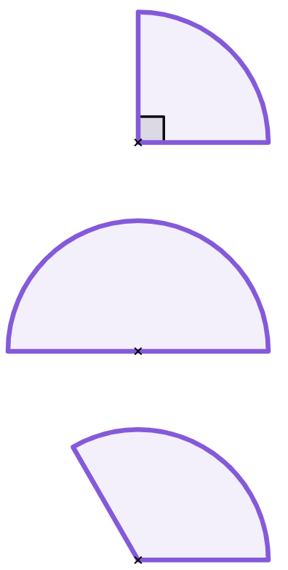
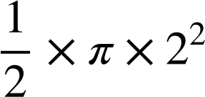
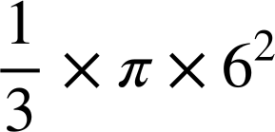


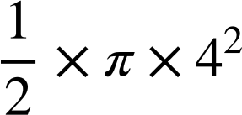
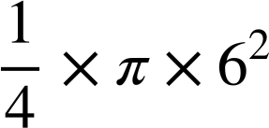


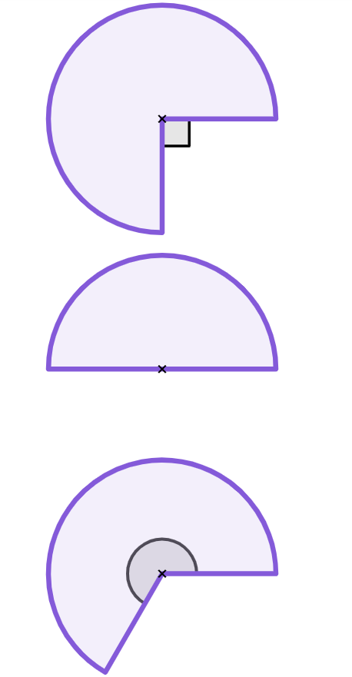
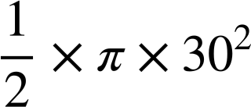

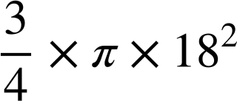

Area of composite shapes
Task A: Finding the area of sectors of a circle
1) Match the circle sectors with the possible correct calculations and answers. Some calculations do not match with a sector.
1
2
3
120°
r = 6 cm
r = 4 cm
r = 6 cm
a
b
e
f
c
d
g
h
2) Complete the table. Give your answer both as a decimal (rounded to 1 d.p.) and in terms of π.
sector | step 1 | step 2 | answer (cm²)
 |  |  | 763.4
 |  |  | 2166π
a)
30 cm
b)
18 cm
c)
240°
57 cm

Slide 2
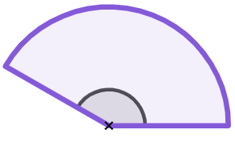
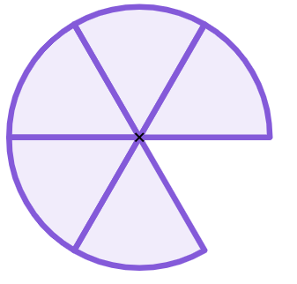
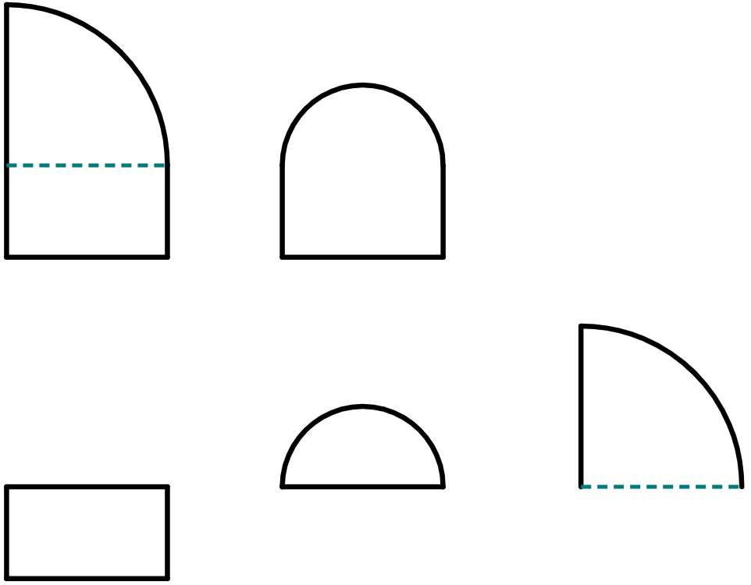
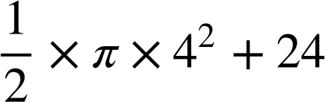
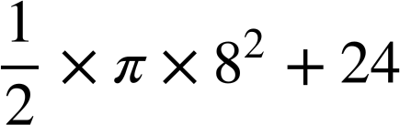
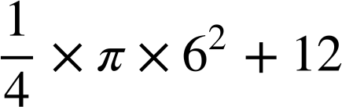
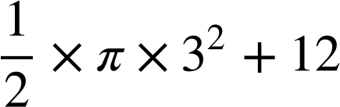
Area of composite shapes
2) Complete the table. Give your answer both as a decimal (rounded to 1 d.p.) and in terms of π.
sector | step 1 | step 2 | answer (cm²)
d)
d = 160 cm
e)
150°
84 cm
f)
7.2 cm
Task B: Finding the area of composite shapes with sectors
1) Match the composite shape to its component parts and calculations.
a
3 cm
d
2 cm
g
8 cm
6 cm
6 cm
2 cm
h
shape 1
b
e
8 cm
4 cm
i
3 cm
j
8 cm
c
f
shape 2
6 cm
3 cm
‹#›

Slide 3
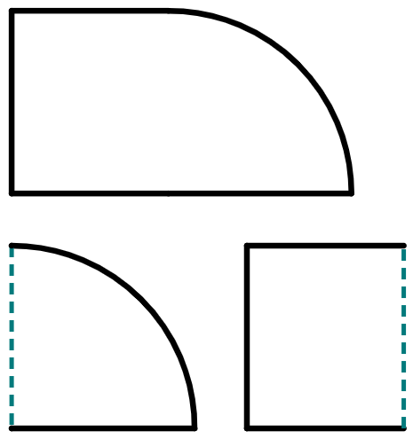
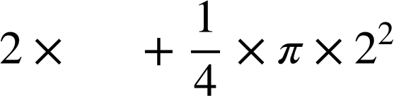
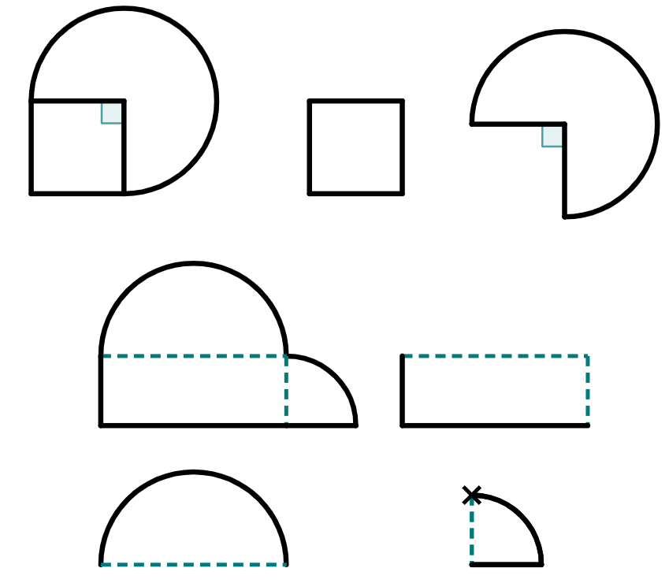

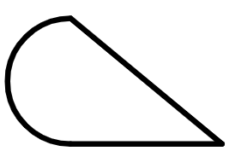
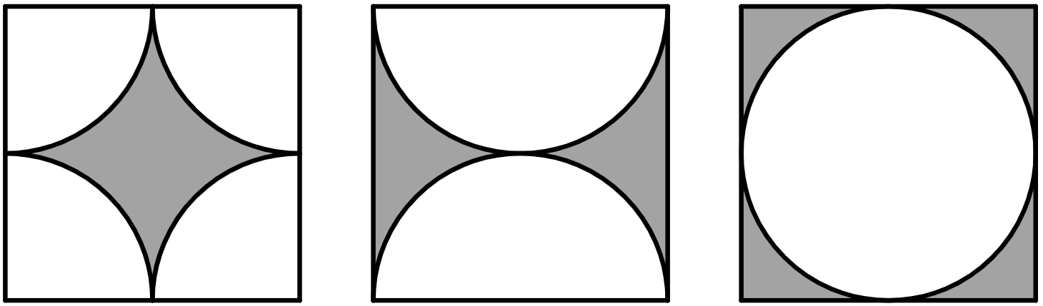
Area of composite shapes
2) Complete the table. Give your answer as both a decimal and in terms of π
shape | shape broken into parts | calculations (addition) | answer
 |  |  | 889.2 cm²
a)
7
7 cm
___ cm
2 cm
2 cm
___
b)
___
12 cm
32 cm
___
32 cm
12 cm
___
___
c)
d)
24 cm
28 cm
44 cm
3) What do you notice about the areas of each shaded region?
Show your working to support your observations.
8 cm
Mathematics in Education and Industry.
‹#›
‹#›

